Slide 1

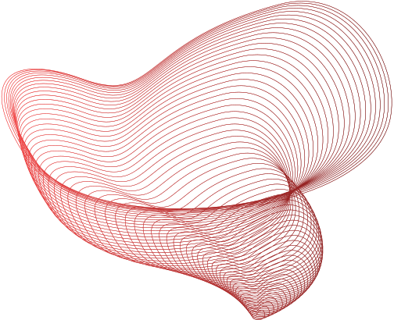
CIE 3 PPT CN
PARITY BIT CHECKER METHOD
(error detection )
Submitted By:
Merwin Pinto
Diya Oswal

Slide 2
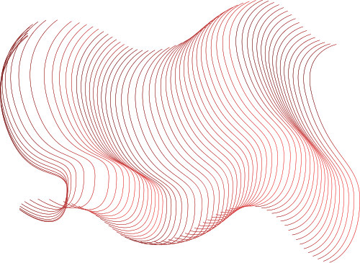


About the Problem Statement
IMPLEMENTING A PARITY BIT CHECKER WHICH IS ERROR DETECTION METHOD

Slide 3
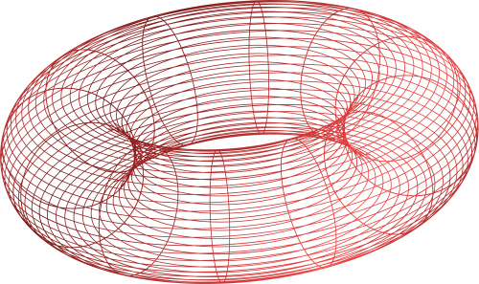
MISSION | To create a Simple parity bit Checker to check Binary data in messages when sent and received
SOLUTION | Converting our message to binary Dividing into frames Checking the Frames whether Even or Odd Parity. Accuracy of message checked at last when message received is corrupted or not
Our Mission and solution

Slide 4
Part1
Message representation into Binary bits and frames
Message representation into binary bits and frames is a crucial process in digital communication, enabling the transmission of data over a communication channel. This process involves converting text messages into a sequence of binary bits
Word : Hello, world!
010010000110010101101100011011000110111100101100001000000101011101101111011100100111001001101100011001000010000

Slide 5
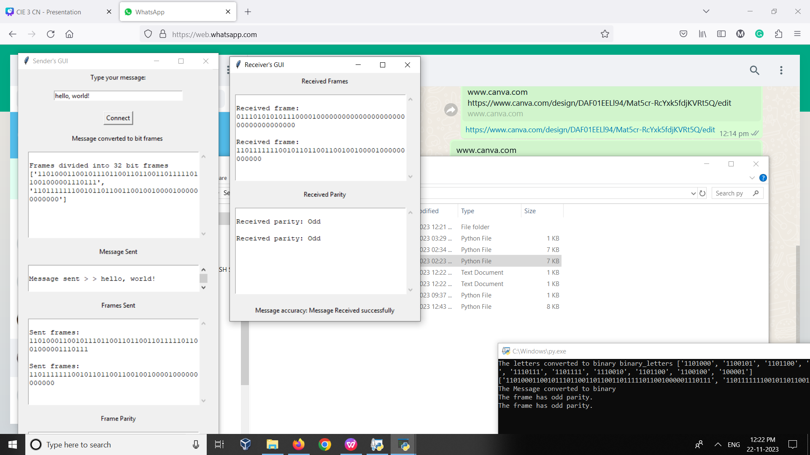
Here Message converted to data frames
Each of the Charcters are converted to ASCCI encoded binary representation

Slide 6
Part 2
Parity bit checking using Even and odd parity concepts
Parity bit checking is a simple and efficient error detection technique that involves adding an extra bit to the data The parity bit is calculated based on the number of 1s in the data, and it is set to either 0 or 1 to make the total number of 1s even (even parity) or odd (odd parity).

Slide 7
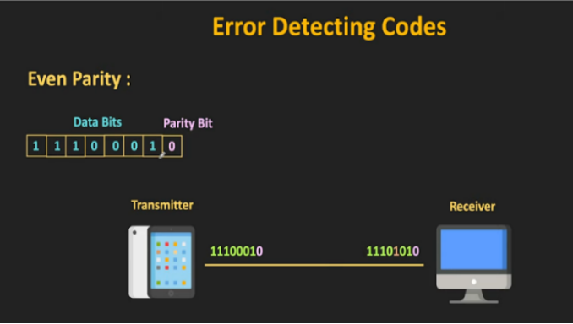
Even Parity
The total number of 1n’s in the code , including parity bit should be even
Example
1 0 1 1 0 0 1 X
As the total number of 1ns in this is four its an even number of 1n’s so we add a parity 0 to it making it Even parity , ie even number of 1ns maintained
1 0 1 1 0 0 1 0

Slide 8
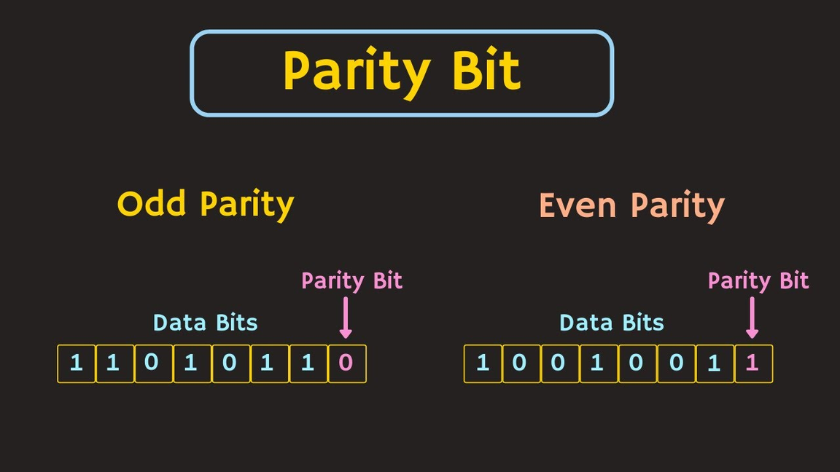
Odd Parity
The total number of 1n’s in the code , including parity bit should be odd
Example
As the total number of 1ns in this is four its an even number of 1n’s so we add a parity 1 to it making it odd parity , ie odd number of 1ns maintained
1 0 1 1 0 0 1 1
1 0 1 1 0 0 1 X

Slide 9
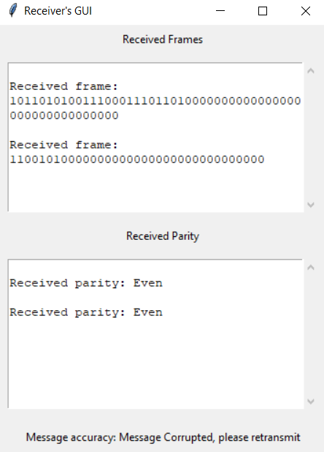
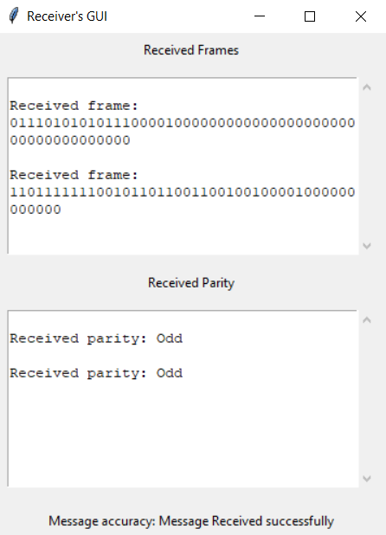
Examples of Parities even and odd
Hey there
Hello, world!

Slide 10
Part 3
GUI Implemetation with server and sender
and analysis with other detection code methods
Here we implented the Entire GUI of our Simulation where we start right from starting the server and receiving messages from sender and receiver gets it if the message transmitted is right it gets transmitted else retransmit the messages

Slide 11
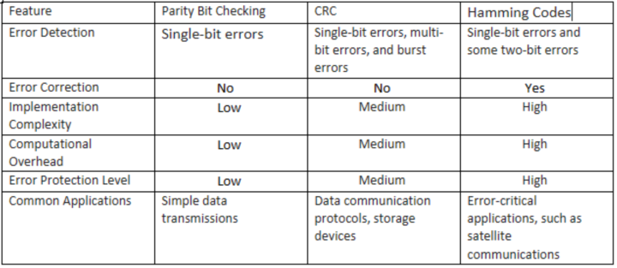
Part 3
Comparison with other Error detection methods

Slide 12
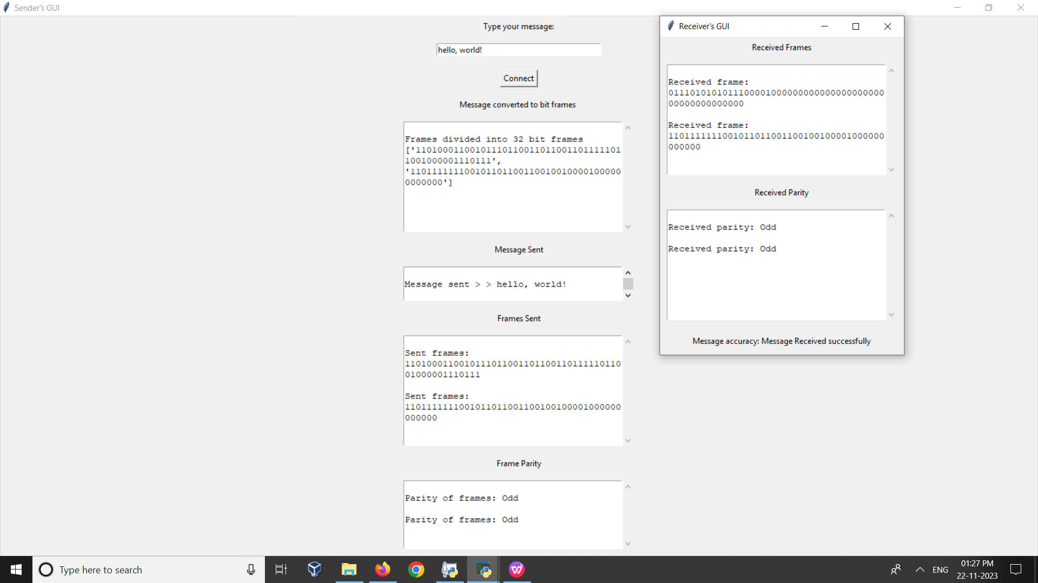
FINAL OUTPUT

Slide 13
Thank
you!

